Slide 1
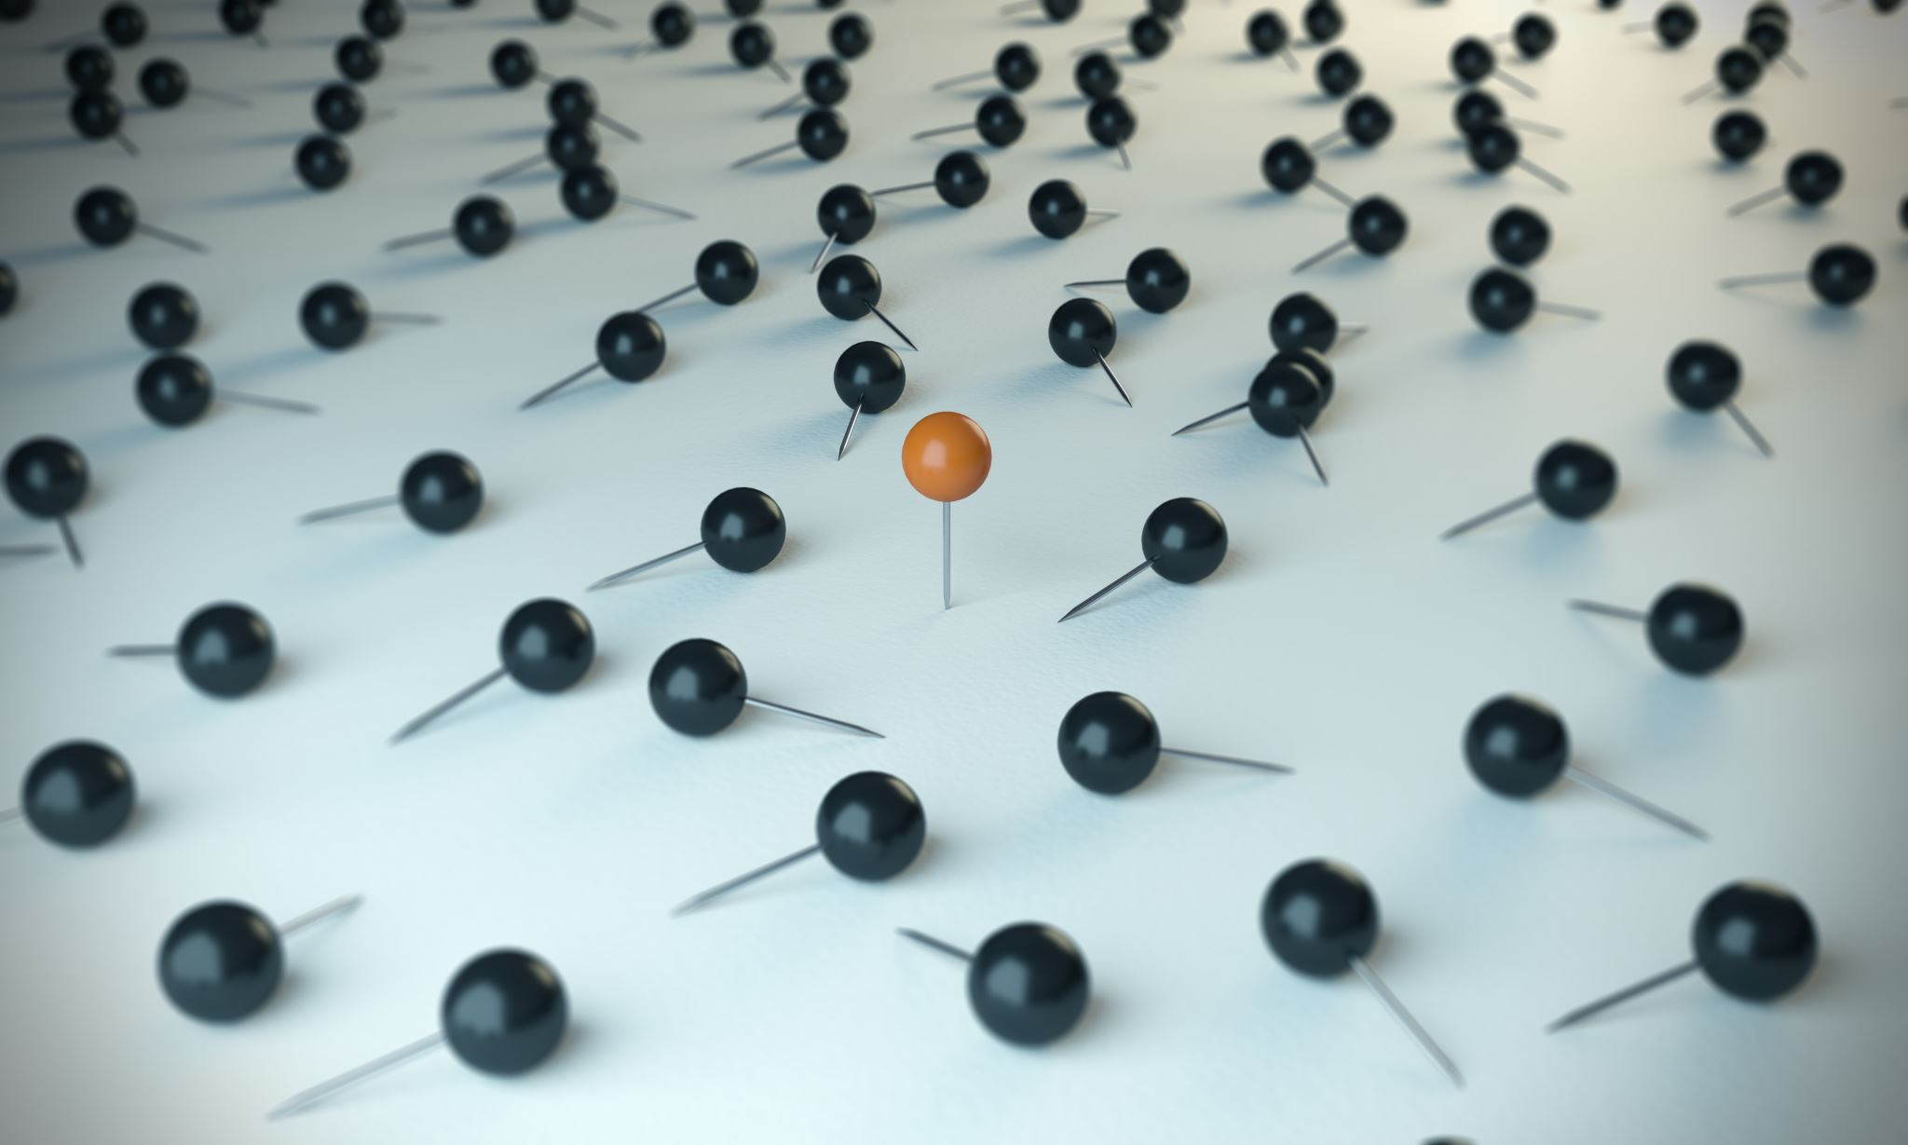
Kaggle Competition: FLOWER CLASSIFICATION USING TPU
Team:
Apoorva Nerkar
Rohit Nagpal

Slide 2
INTRODUCTION (1/2)
Description:
For our project we decided to participate in an active Kaggle competition of Flower Classification with TPU's. TPU, which stands for Tensor Processing Unit, are powerful hardware accelerators specialized in deep learning tasks.
Objective:
The objective of the competition is to build a Deep Learning model to classify 104 types of flowers using TPUs.
As we know, training a deep learning model with high resolution images is very time consuming and resource exhaustive, without using GPUs or TPUs, it can take up to hours to train the model even for 1 epoch whereas it could be done within seconds using GPUs and TPUs.
Therefore, the main objective of this competition is to make sure competitors learn to use the TPUs and analyze how the solutions are accelerated by TPU's.

Slide 3
INTRODUCTION (2/2)
Difference between CPU, GPU and TPU:
CPU (Central Processing Unit): CPU is a general-purpose processor means a CPU works with software and memory. A CPU store the calculation results on memory thus limiting the total throughput and consuming significant energy.
GPU (Graphics Processing Unit): To gain higher throughput than a CPU the modern GPU usually has 2,500–5,000 ALUs in a single processor that means we could execute thousands of multiplications and additions simultaneously. But, the GPU is still a general purpose processor and GPU need shared memory to read and store the intermediate calculation results.
TPU (Tensor Processing Unit): In case of TPU, instead of having a general-purpose processor, it has a matrix processor specialized for neural network workloads. They can handle the massive multiplications and additions for neural networks, at blazingly fast speeds while consuming much less power and inside a smaller physical footprint.

Slide 4
DATA DESCRIPTION AND DATA PREPARATION
Dataset Description:
In this competition we are classifying 104 types of flowers based on their images drawn from different public datasets. The images provided are of 4 different size:
192x192
224x224
331x331
512x512
Some classes are very narrow, containing only a sub-type of flower (e.g. pink primroses) while other classes contain many sub-types (e.g. wild roses).
Data Format:
The images provided are in TFRecord format. The TFRecord format is a container format frequently used in Tensorflow to group and shard data files for optimal training performance.
All the different sizes of images have been classified into 3 segments - Train, Validation (with labels) and Test (without labels)

Slide 5
MODEL DESCRIPTION (1/2)
EfficientNet-B7:
The model architecture uses mobile inverted bottleneck convolution (MBConv) .
The MBConv blocks have 3 features:
Depthwise Convolution + Pointwise Convolution It divides original convolution to two steps to reduce computational cost significantly with minimal accuracy loss.
In MBConv, blocks are composed with a layer that first expands channels, then squeeze them, so layers that have less channels are skip-connected.
Linear Bottleneck - It uses linear activation in the last layer in each block to prevent information loss from ReLU
There are two types of “weights” that can be used with the model:
Imagenet: ImageNet is an image database. Images in the database are organized into a hierarchy, with each node of the hierarchy depicted by hundreds and thousands of images
Noisy-Student: Self-training with Noisy Student improves ImageNet classification. First train an EfficientNet model on labeled ImageNet images and use it as a teacher to generate pseudo labels on 300M unlabeled images

Slide 6
MODEL DESCRIPTION (2/2)
DenseNet201:
Dense Convolutional Network (DenseNet) connects each layer to every other layer in a feed-forward fashion .
Whereas traditional convolutional networks with L layers have L connections - one between each layer and its subsequent layer - our network has L(L+1)/2 direct connections
DenseNet models have several compelling advantages: they alleviate the vanishing-gradient problem, strengthen feature propagation, encourage feature reuse, and substantially reduce the number of parameters.
In DenseNet, each layer obtains additional inputs from all preceding layers and passes on its own feature-maps to all subsequent layers.
Densenet contains a feature layer (convolutional layer) capturing low-level features from images, serveral dense blocks, and transition layers between adjacent dense blocks.
Used ImageNet weights: ImageNet is an image database organized according to the WordNet hierarchy (currently only the nouns), in which each node of the hierarchy is depicted by hundreds and thousands of images.

Slide 7
ALTERNATIVE MODELS (1/2)
Modelling using GPU and TPU:
CNN model for input size of (192,192,3) and (224,224,3) using GPU:
Layers: Conv2D, BatchNormalization. Dropout and GlobalAveragePooling2D (or Flatten)
Regularizer: EarlyStopping with 30 Epochs
Dataset: 12753 training, 3712 validation images, 7382 unlabeled test images
Performance: ~70-72% Validation Accuracy
Time taken: Avg. 3 to 4 hours along with "Resource Exhausted“ error for size (331 & 512)
CNN model for input size of (331,331,3) and (512,512,3) using TPU:
Layers: Conv2D, BatchNormalization. Dropout and GlobalAveragePooling2D (or Flatten)
Regularizer: EarlyStopping with 30 Epochs
Dataset: 12753 training, 3712 validation images, 7382 unlabeled test images
Performance: ~74-76% Validation Accuracy
Time taken: Avg. 1.5 to 2 hours
Conclusion: From mentioned stats we can conclude that TPU not only helped in processing the model at faster rate but also helped in improving the accuracy of the model.

Slide 8
ALTERNATIVE MODELS (2/2)
Modelling using pre-trained Models (VGG16, DenseNet201 & EfficientNetB7):
Fine tuning using VGG16 with and without LearningRateScheduler :
Layers: VGG16, GlobalAveragePooling2D (or Flatten)
Regularizer: EarlyStopping with 30 Epochs and 50 Epochs having LearningRateScheduler
Dataset: 12753 training, 3712 validation images, 7382 unlabeled test images
Performance: ~95-96% Training Accuracy
Time taken: Avg. 1.5 to 2 hours
Fine tuning using DenseNet and EfficientNet EB7 along with LearningRateScheduler :
Layers: DenseNet201, GlobalAveragePooling2D (or Flatten)
Regularizer: EarlyStopping with 50 Epochs, LearningRateScheduler
Dataset: For Training used sets of both Training and Validation - 12753 training, 3712 validation images
Performance: ~99-100% Training Accuracy
Time taken: Avg. 2 to 3 hours
Conclusion: Model took more time to converge due to low learning rate with higher epochs but resulted in overall higher accuracy.

Slide 9
MODEL OPTIMIZATION
Below optimization techniques were used to optimize the results:
Batch Normalization: Used batch norm in order to speed up models learning process
Dropout: Used dropout in order to prevent models from overfitting
Fine Tuning: Used fine tuning to accelerate the training of neural networks as a weight initialization scheme and feature extraction method
Callbacks: A callback is a set of functions to be applied at given stages of the training procedure. We can use callbacks to get a view on internal states and statistics of the model during training.
Early Stopping: Used early stopping to avoid overfitting and underfitting as too many epochs can lead to overfitting of the training dataset, whereas too few may result in an underfit model.
Learning Rate Scheduler: It adjusts the learning rate over time using a schedule that we write beforehand. This function returns the desired learning rate (output) based on the current epoch (epoch index as input): In our model, we are reducing the learning rate over the time which helps in making large changes at the beginning of training process thus resulting in good weights early and fine tuning them later.

Slide 10
MODEL IMPLEMENTATION
Using Saved Models:
From the implementation and demo perspective, we created a interactive script in Google Colab which does the following:
Load the saved models trained by us. Models are: DenseNet201 and EfficientNetB7
Asks the user to provide any flower image url for the prediction
Download the flower image from the url
Process the image to convert it into size of (512, 512, 3) as our model is trained on that size
Predict the class of the flower and shows with predicted result
Online Application for Flower Classification:
As a potential next step of implementation, we can scale-up this model and build a online application where user would just need to provide the image url or upload the flower image and get to know the class of the flower it belongs to as output

Slide 11
SUBMISSION TO COMPETITION (1/2)
Final Model:
For the prediction of test images we used combined effect of two models – DenseNet and EfficientNet-B7
We took the equal weightage (50%) of prediction from both the models and then used “argmax” function to get the class label with highest probability
Submission:
As a submission we needed to submit a csv file with two fields - id and label
id - a unique ID for each test sample images
label - the class of flower represented by the test sample

Slide 12
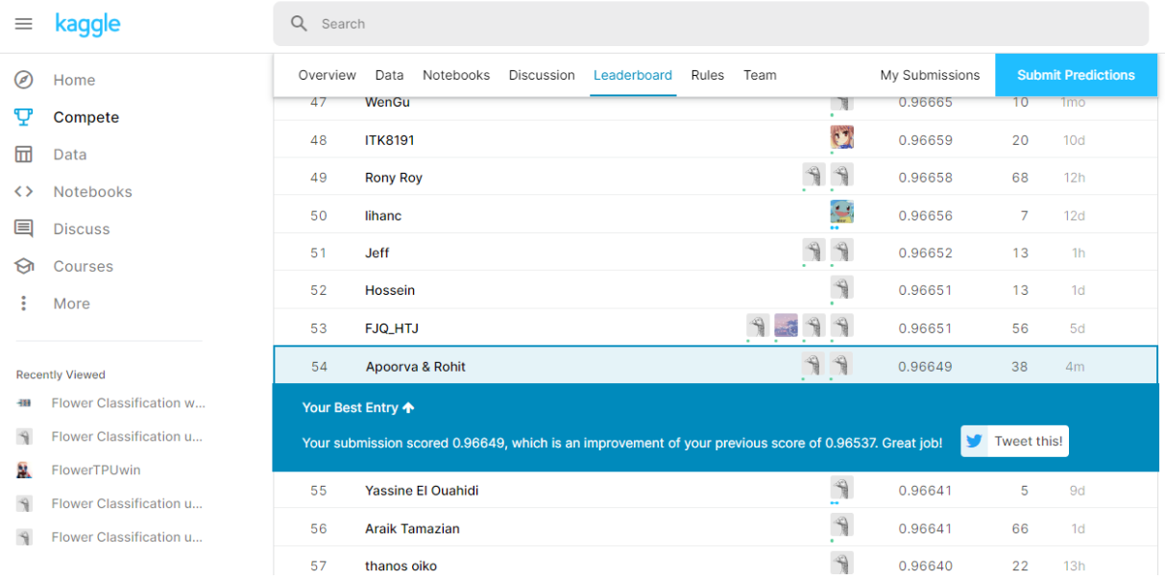
SUBMISSION TO COMPETITION (2/2)
Rank Achieved:
We managed to achieve the least rank of 54 out of ~700 participated teams

